Slide 1
Lecture 1: Introduction to AI
15-381/681
Artifical Intelligence: Representation and
Problem Solving
Fei Fang and Dave Touretzky
Carnegie Mellon University
Based on slides from Tuomas Sandholm and others.

Slide 2
Instructors
Fei Fang
https://feifang.info/
Dave Touretzky
http://www.cs.cmu.edu/~dst/

Slide 3
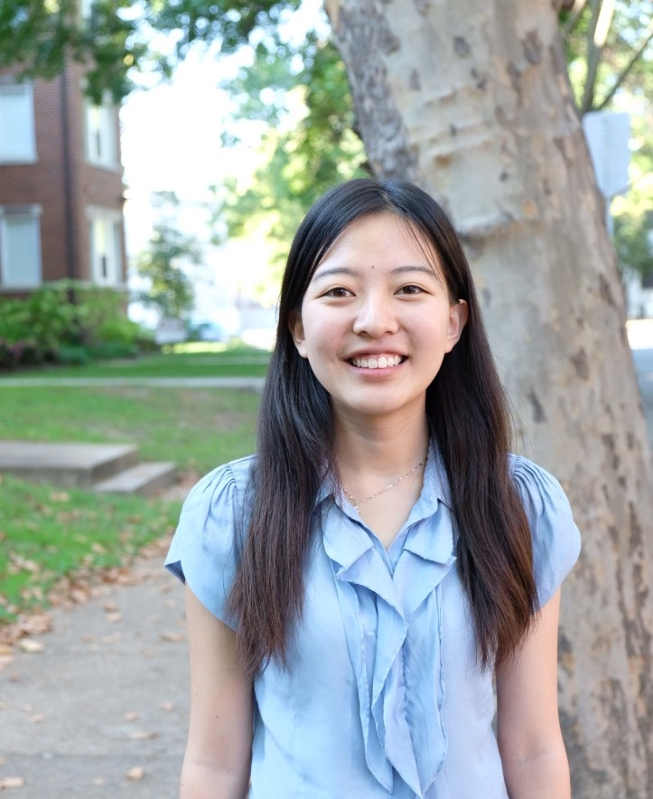
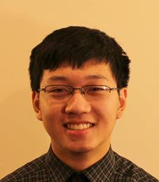
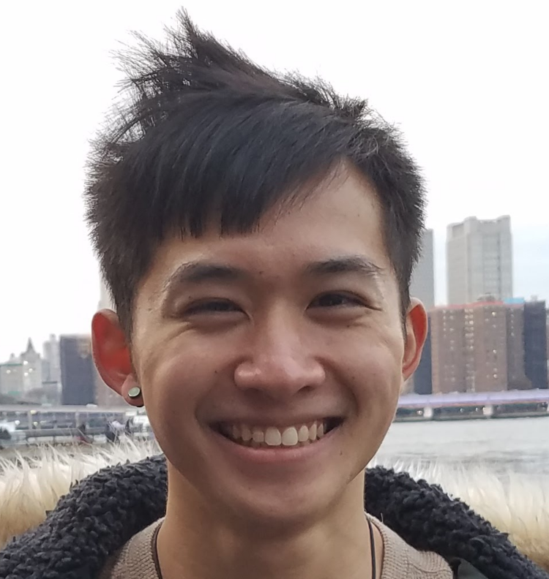
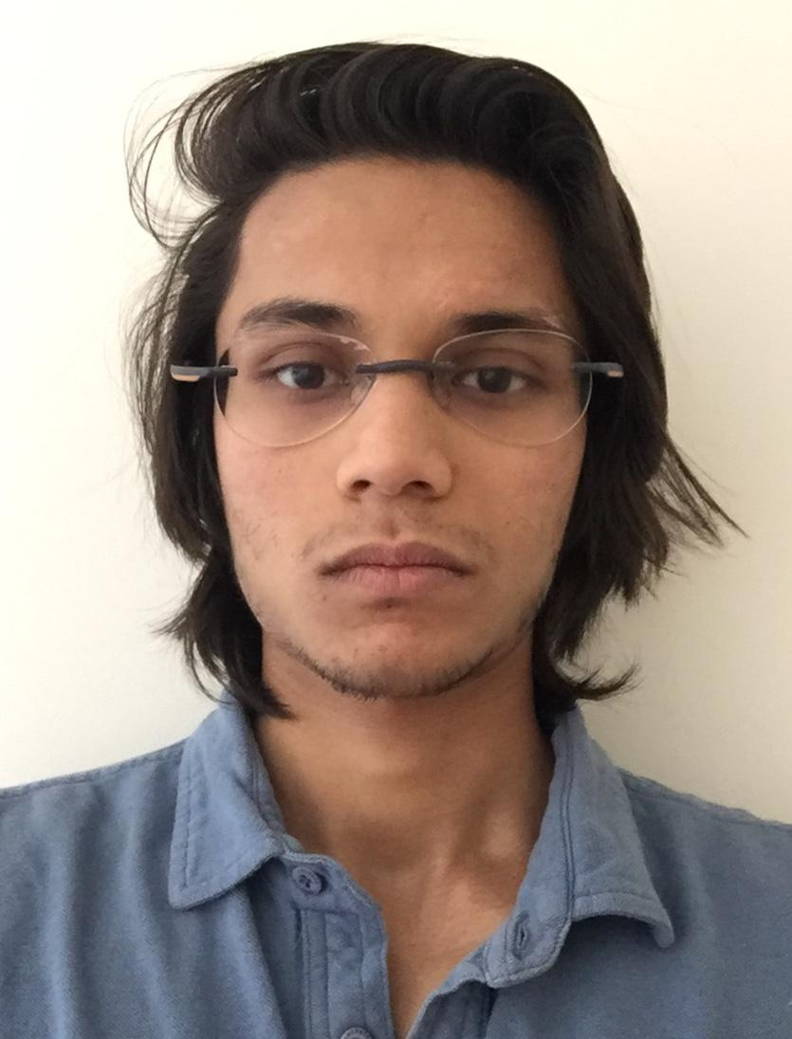
Your Helpful TAs
Richard Gu
Yuan Gao
Gaurav Lahiry
Thomas Z Li
Jonathan Lingjie Li
Tanay Vakharia

Slide 4
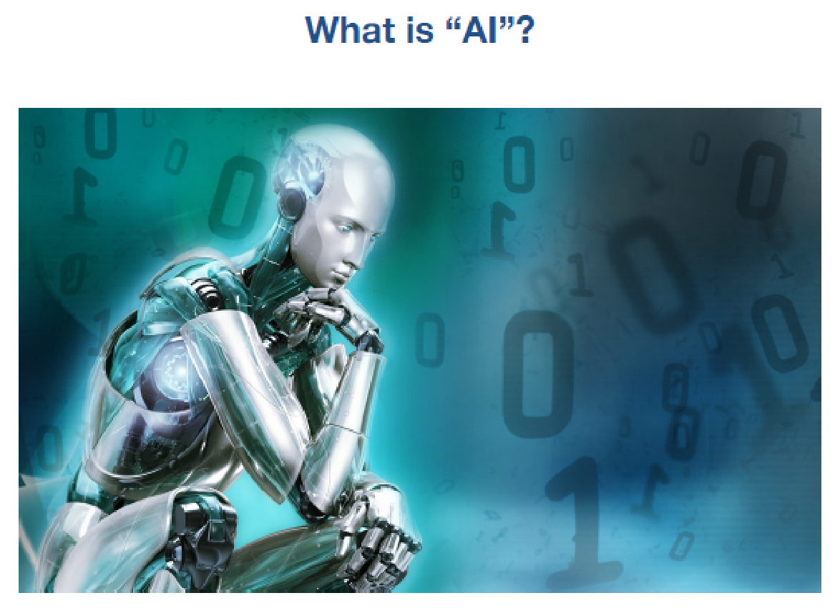

Slide 5
Some classic definitions
Building computers that...
Think like humans cognitive science / neuroscience e.g., General Problem Solver (Newell and Simon, 1961) | Think rationally logic and automated reasoning but not all problems can be solved just by reasoning
Act like humans Turing test ELIZA, Julia, chatbots, Loebner prize | Act rationally basis for intelligent agent framework unclear if this captures the current scope of AI reseach

Slide 6
The pragmatist’s view
AI is that which appears in academic conferences on AI ...

Slide 7
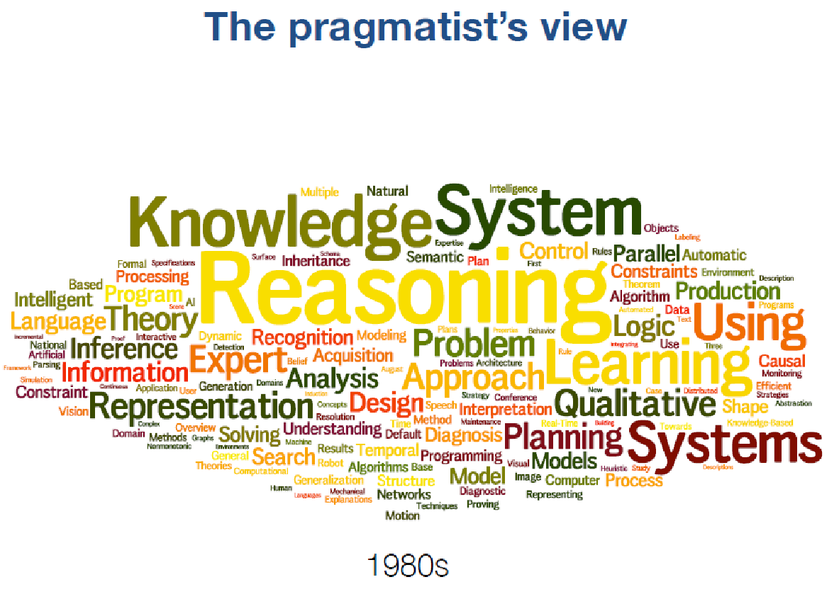

Slide 8
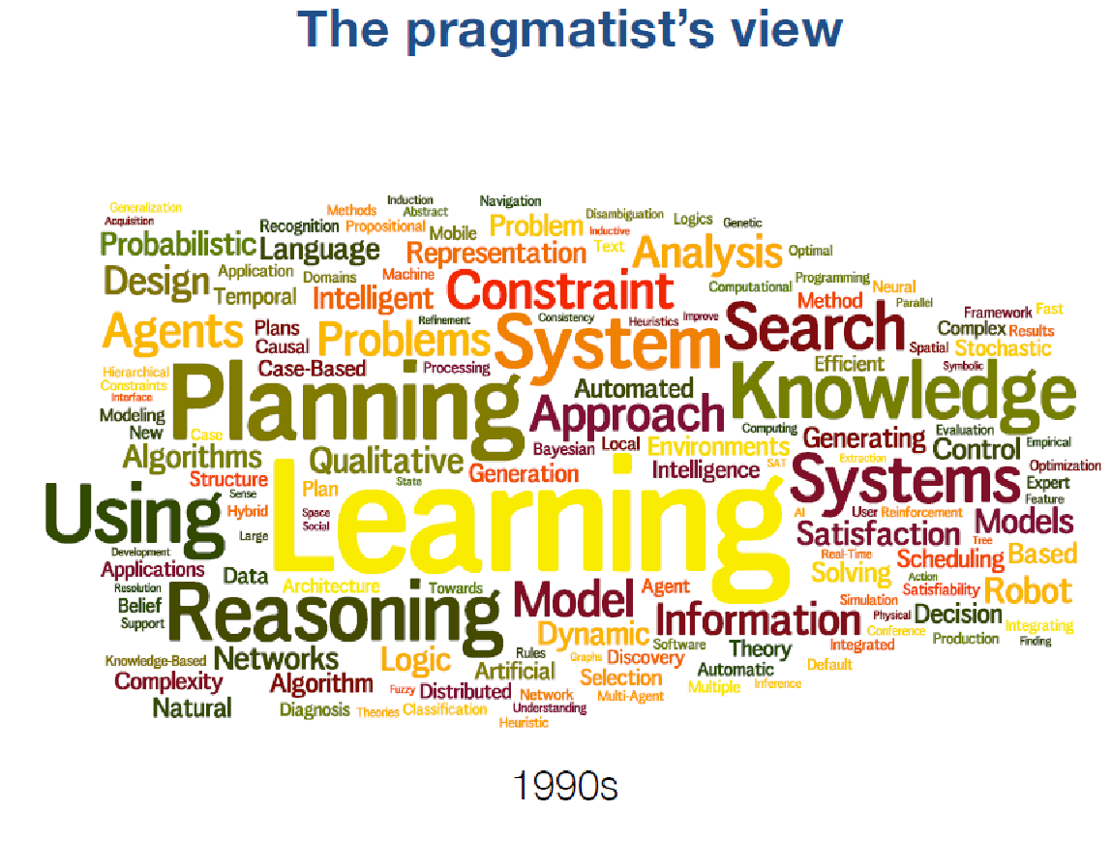

Slide 9
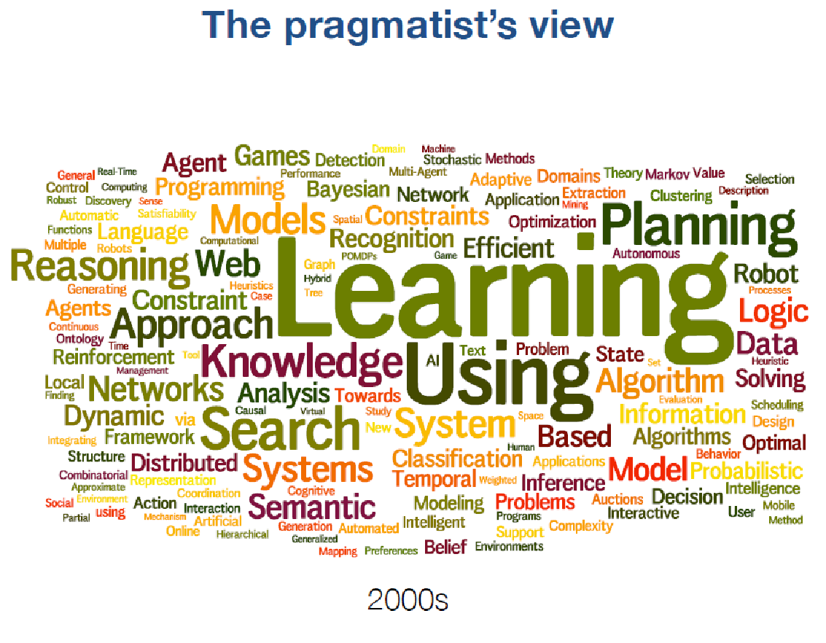

Slide 10
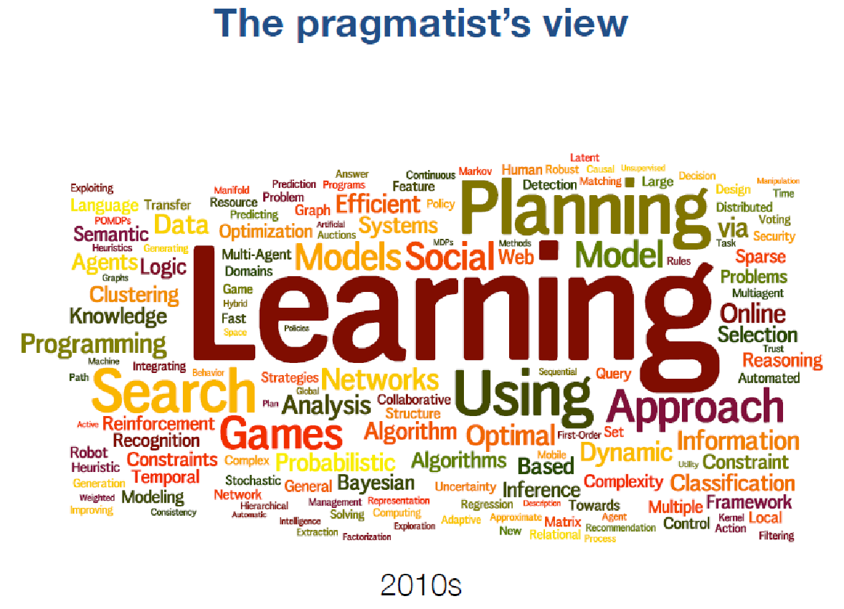

Slide 11
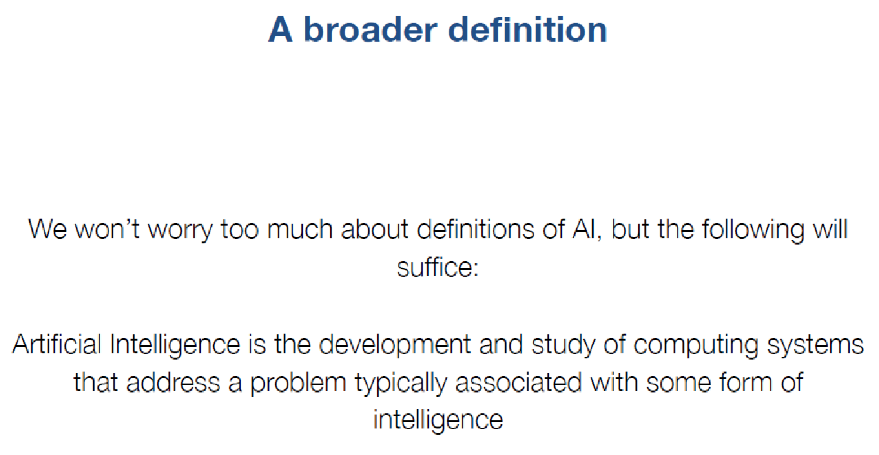

Slide 12
History of AI and
AI today

Slide 13
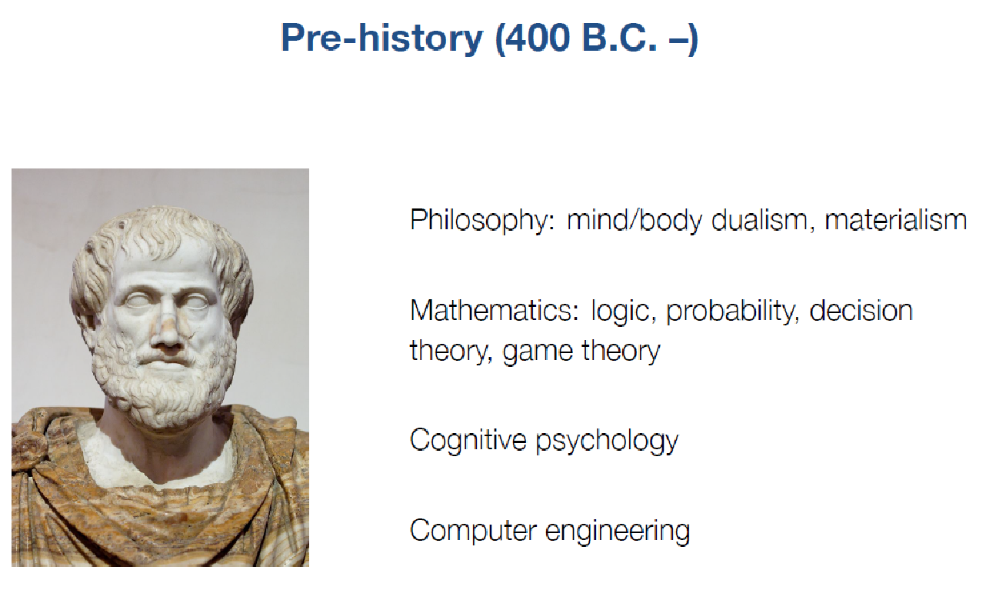

Slide 14
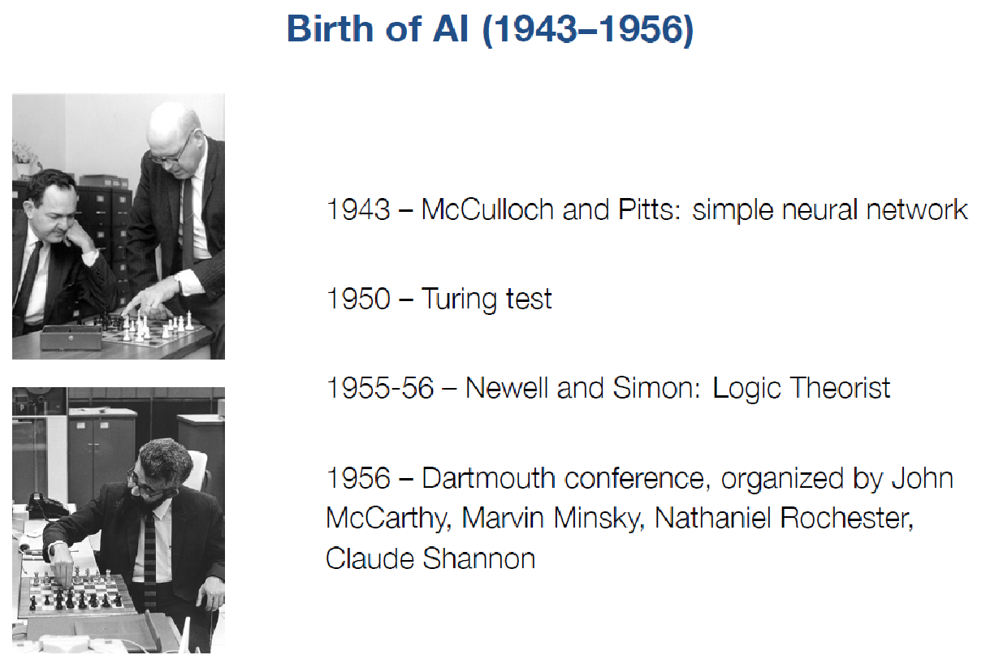
Other attendees were Ray Solomonoff, Oliver Selfridge, Trenchard More, Arthur Samuel, Herbert A. Simon, and Allen Newell

Slide 15
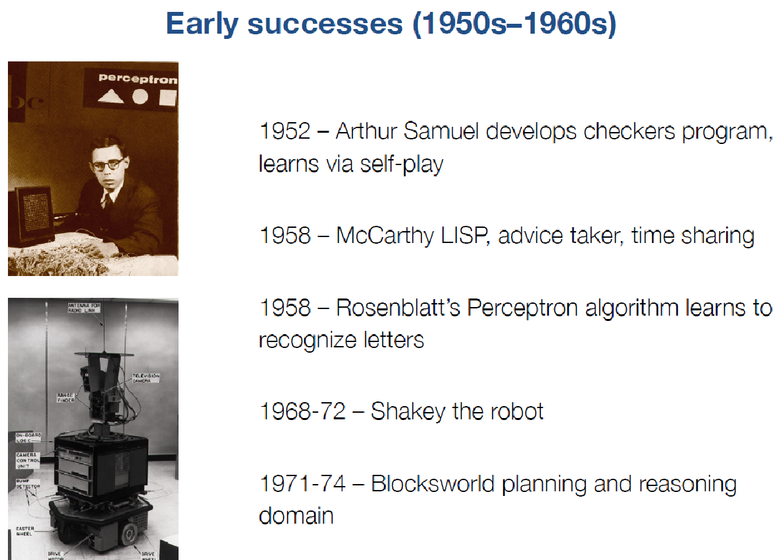
-> A* algorithm

Slide 16
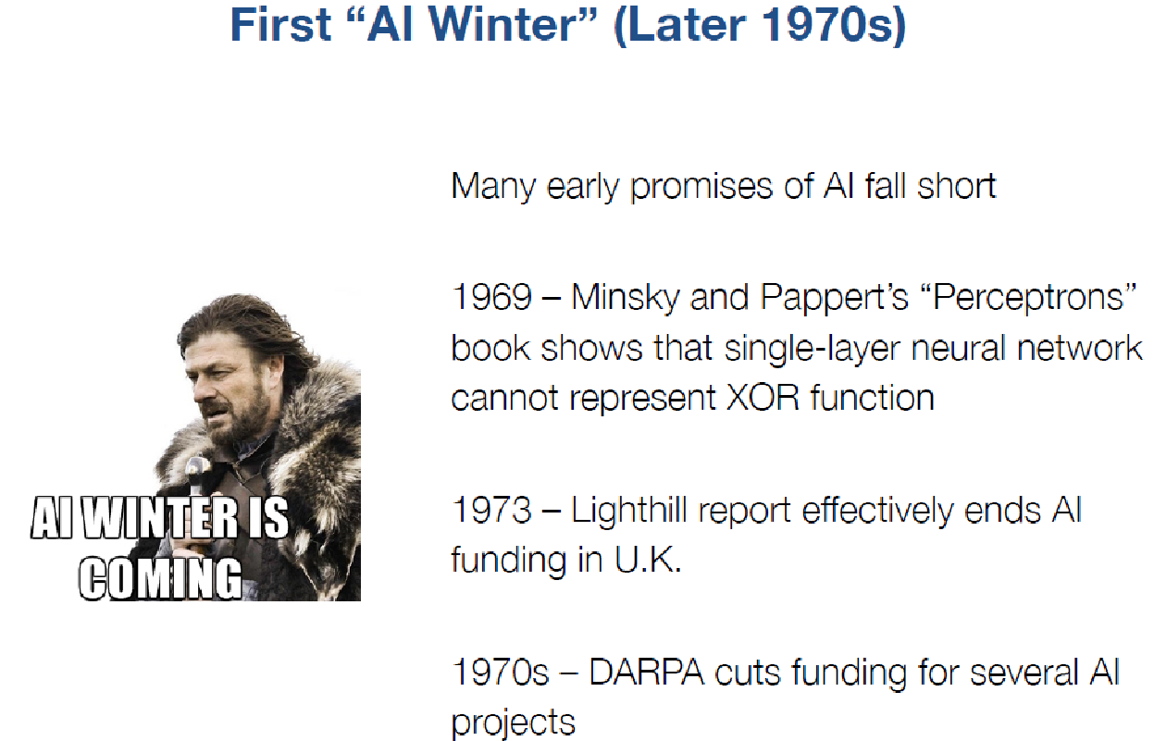

Slide 17
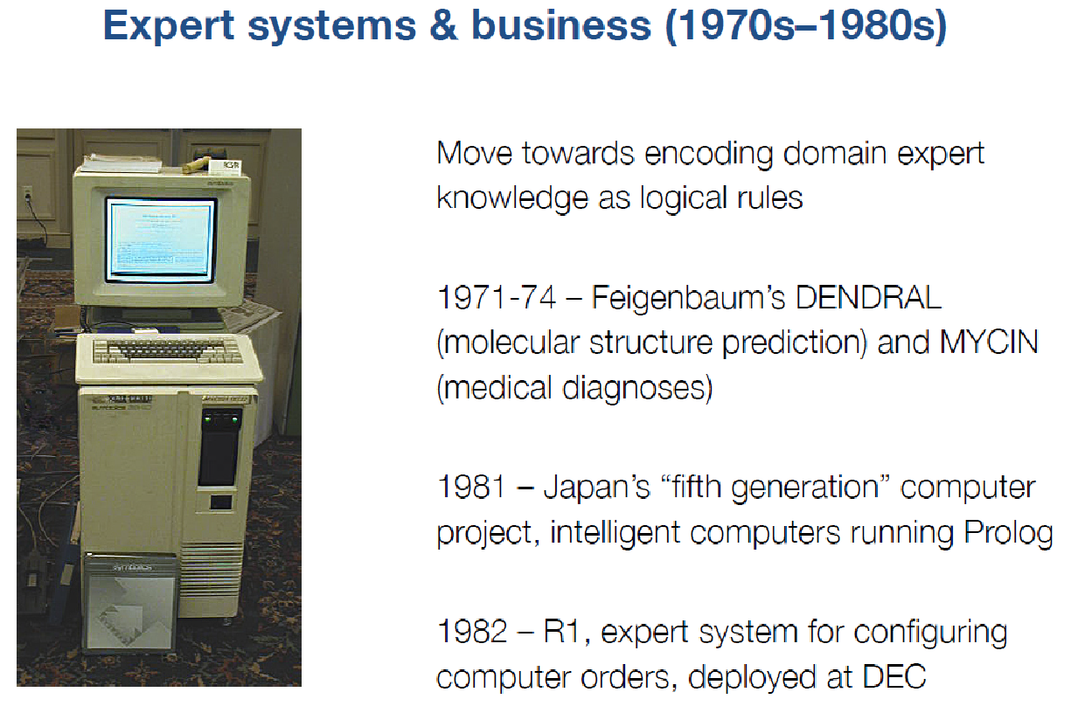

Slide 18
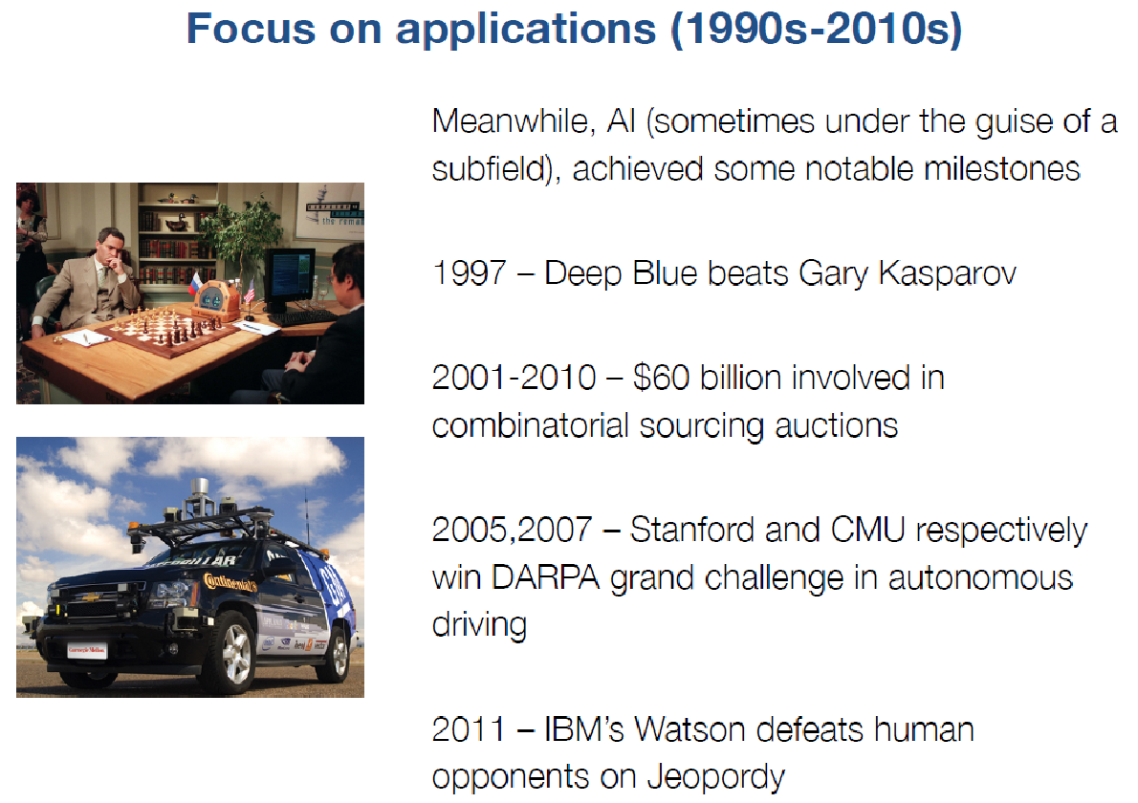

Slide 19
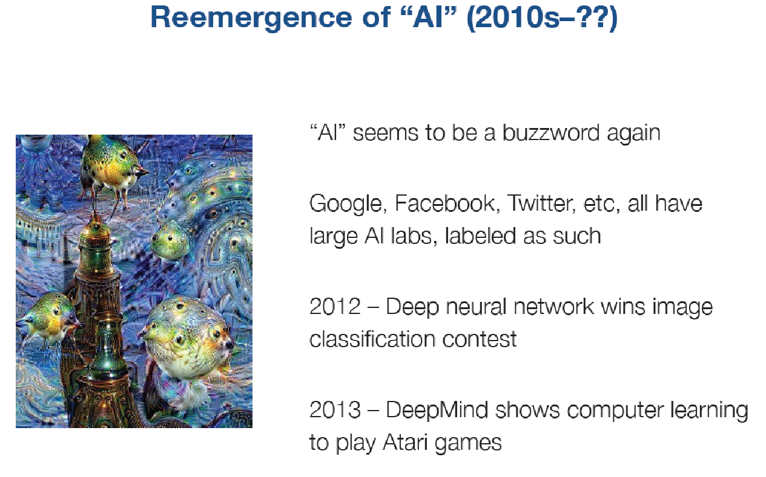
2015-2017 – superhuman speech understanding

Slide 20
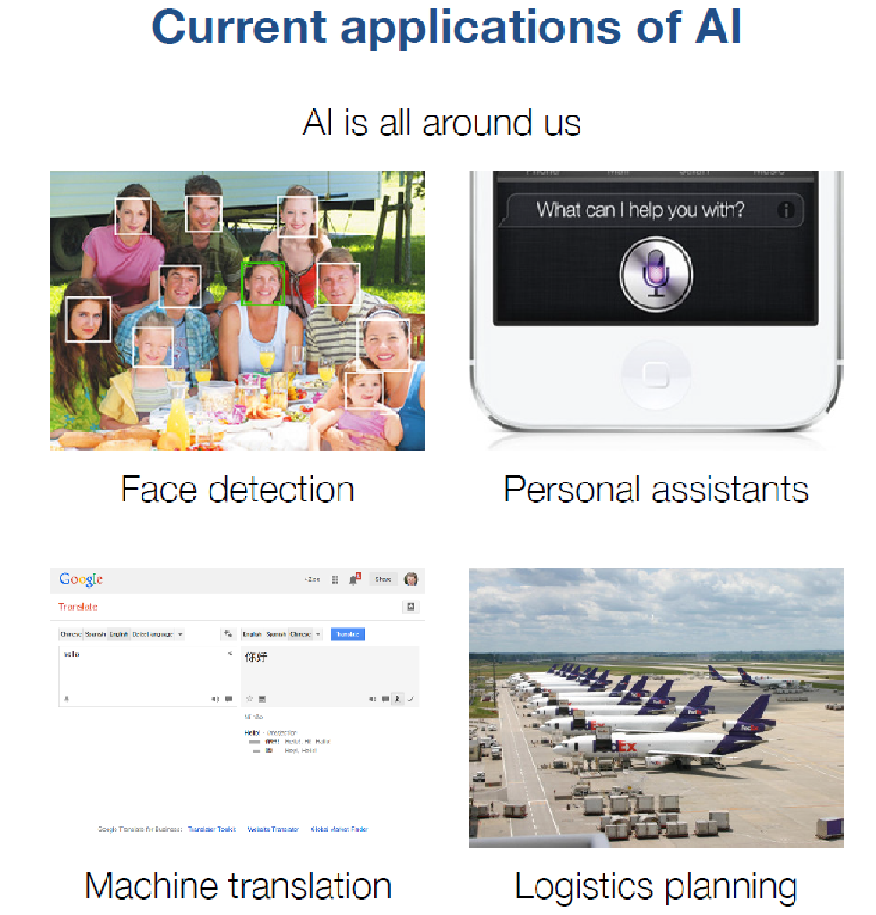

Slide 21
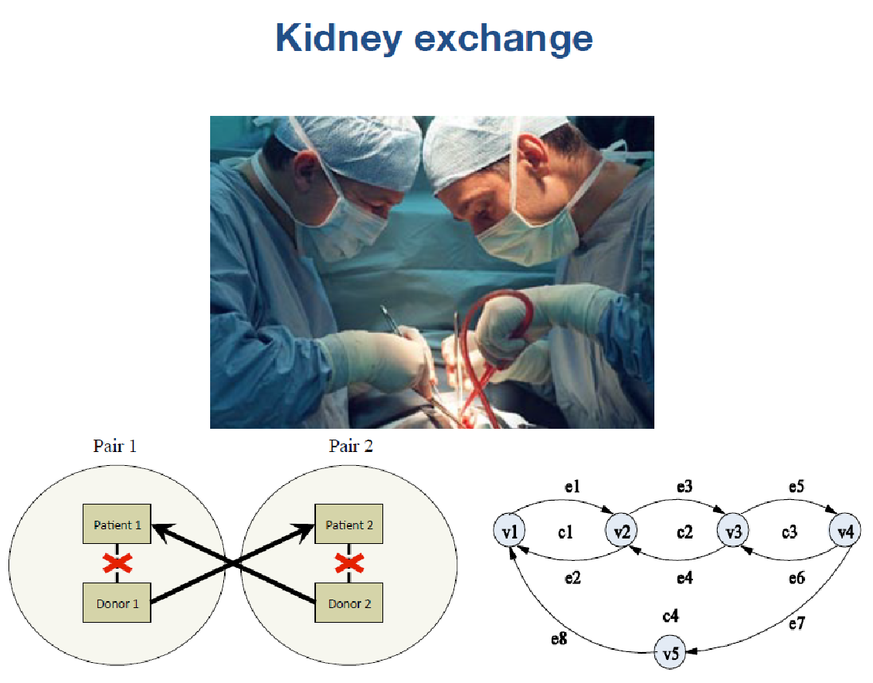
[Sandholm et al.]

Slide 22
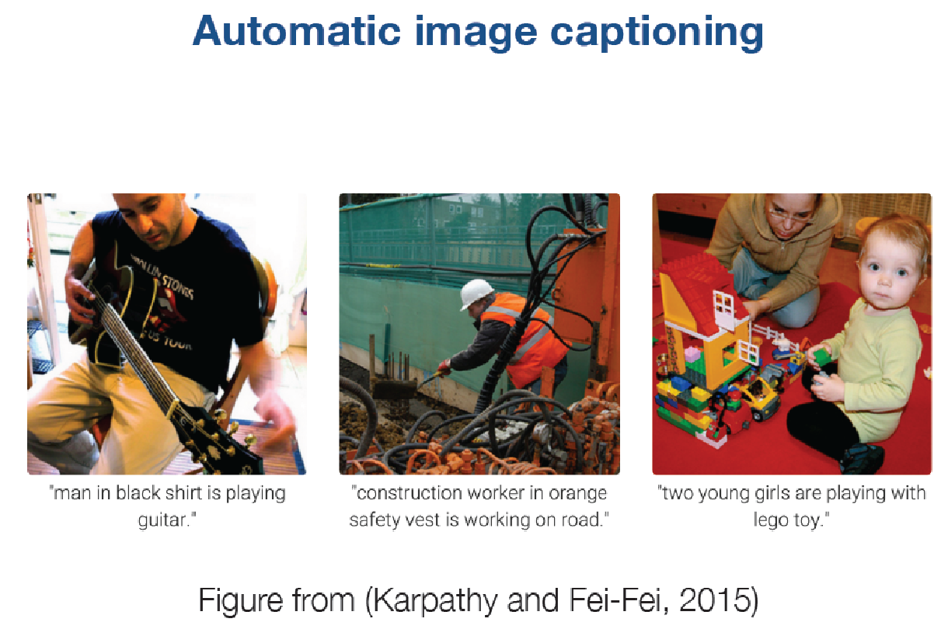

Slide 23
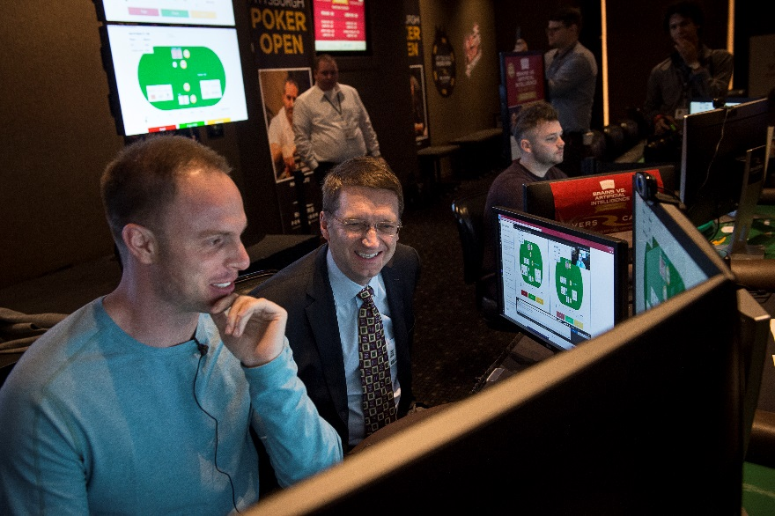
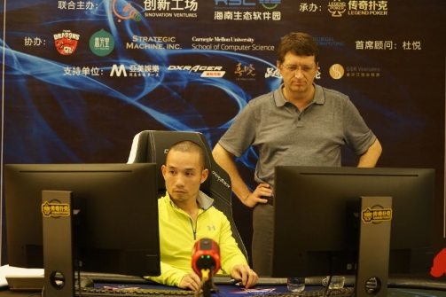
Superhuman strategic reasoning under imperfect information
Libratus beats best humans at heads-up no-limit Texas hold’em poker [Brown & Sandholm]
Pittsburgh, January 2017
Haikou, April 2017

Slide 24
Highly parallel / distributed
Driving trends
  Moore’s law ended 2004 => to continue progress, need highly multi-core
  Software-as-a-Service & clouds
    Access to large-scale resources
    Affordable due to amortization across bursty users
  Big data

Slide 25
Thoughts about goals of AI
AI has many different goals
  This is nothing to avoid
  E.g., OR has same “problem” and is not shy about it
Shouldn’t define AI as that which still cannot be done
Human-level intelligence just a milestone along the way
Q: Will there be a super-human species?
A: No, AIs will be tools for various purposes

Slide 26
Some potential new AI applications with huge positive impact on the world
Better electricity markets
Combinatorial CO₂ allowance / pollution credit markets
Automated market making
Campaign market for advertising
Security games
  Physical, information, malware protection, …
  Sequential

Slide 27
AI is a fast-moving exciting area
We can directly make the world a better place

Slide 28
Course Changes From Last Year
Tighter focus: Representation and Problem Solving
What’s left out?
  Computer vision
  Machine learning; neural networks
  Natural language understanding; speech recognition
  Robotics
Why?
  We have entire courses on those other topics.
  The new undergrad AI major will require several of these.
  Now we can go into greater depth in our topic areas.

Slide 29
Learning Objectives
Describe AI concepts, models, algorithms
Model real-world problems using AI models
Implement AI algorithms introduced in class
Deliver written and oral presentation (for students in 15-681)

Slide 30
Pre-requisites
There are no formal pre-requisites for the course, but students should have previous programming experience (programming assignments will be in Python), as well as general CS background.
Please see the instructors if you are unsure whether your background is suitable for the course.

Slide 31
Major Topics In This Course
Search
Satisfiability
Optimization
Deterministic/symbolic reasoning
Knowledge representation
Probabilistic reasoning
Sequential decision making
Multi-agent systems
One homework assignment in each topic area.

Slide 32
Masters Version (15-681)
Same homework assignments as 15-381
Additional requirement: course project
  Need to be approved by the professors
  Submit proposal by 10/9
  Can be done individually or by a pair of students (double the scope)
  Can include
    using algorithms from class on a new application
    making a new algorithm
    developing a system that uses AI techniques
    programming or proving theorems.
Presented orally and as a paper

Slide 33
Grading
15-381:
  Homeworks 50%
  Midterm 25%
  Final 25%
15-681:
  Homeworks 37.5%
  Midterm 18.75%
  Final 18.75%
  Final project 25%
Final Grade: Letter graded

Slide 34
Late Policy
Assignments submitted past the deadline will incur the use of late days.
You cannot use more than 2 late days per homework. No credit will be given for homework submitted more than 2 days after the due date.
You have 6 “free” late days. After your 6 late days have been used you will receive 20% off for that homework for each additional day late. (Again, no more than 2 late days per homework)
Late days do not apply to course project for 15-681

Slide 35
Disability Accommodations
If you have a disability and have an accommodations letter from the Disability Resources office, we encourage you to discuss your accommodations and needs with us as early in the semester as possible.
We will work with you to ensure that accommodations are provided as appropriate.
If you suspect that you may have a disability and would benefit from accommodations but are not yet registered with the Office of Disability Resources, we encourage you to contact them at access@andrew.cmu.edu.

Slide 36
Academic Integrity
Strict honor code with severe punishment for violators. CMU’s academic integrity policy can be found here: https://www.cmu.edu/student-affairs/ocsi/
You may discuss assignments with other students as you work through them, but writeups must be done alone.
No downloading / copying of code or other answers is allowed.
If you use a string of at least 5 words from some source, you must cite the source

Slide 37
Office Hours
Instructors’ office hours
  Fei Fang (feif@andrew.cmu.edu): Tue 3pm-4pm when she lectures at Wean Hall (WEH) 4126
  Dave Touretzky (dst@cs.cmu.edu): Tue 3pm-4pm when he lectures at GHC 9013
TAs’ office hours are all at GHC 5th Floor Teaching Commons
  Richard Gu (rgu1@andrew.cmu.edu): Wed 4pm-5pm
  Yuan Gao (yaog1@andrew.cmu.edu): Tue 11am-12pm
  Gaurav Lahiry (glahiry@andrew.cmu.edu): Mon 2pm-3pm
  Thomas Z Li (tzl@andrew.cmu.edu): Mon 12pm-1pm
  Jonathan Lingjie Li (jlli@andrew.cmu.edu): Fri 4pm-5pm
  Tanay Vakharia (tvakhari@andrew.cmu.edu): Thu 4pm-5pm

Slide 38
Resources
Course webpage: https://www.cs.cmu.edu/~./15381/
Course lecture recording (no live stream): navigate to the tab "Panopto Recordings" on Canvas page (https://canvas.cmu.edu/courses/6533)
Piazza: https://piazza.com/cmu/fall2018/15381/home for Q&A, discussion, in-class quizzes.
  For all course content-related questions, please post on Piazza instead of writing emails to instructor/TA
Textbook: Artificial Intelligence: A Modern Approach, Third Edition by Stuart Russell and Peter Norvig
Other reading material for each lecture: See course webpage

Slide 39
Student Well-Being
Start early! Avoid last-minute panic.
CMU services and resources are available, and treatment does work
  http://www.cmu.edu/counseling/
  412-268-2922
Take care of yourself

Slide 40
Reading
Read Russel & Norvig chapters 1 and 2 for today’s lecture.
Read sections 3.1-3.4 for Thursday’s lecture.

Slide 41
Quiz 1
What is the rank of the following matrix?
[2, -1, 3;
1, 0, 1;
0, 2, -1;
1, 1, 4]
A: 0
B: 1
C: 2
D: 3
E: 4
Notes:
3 - Apply row operations to get an upper triangular matrix

Slide 42
Quiz 2
a1 and a2 are 1-dimensional real variables. Let a=(a1, a2), q=(q1, q2) where q1=exp(a1)/(exp(a1)+exp(a2)) and q2=exp(a2)/(exp(a1)+exp(a2)). What is the Jacobian matrix of q at a?
A: [0, q1; q2, 0]
B: [q1-q1^2, q1q2; q1q2, q2-q2^2]
C: None of above
Notes:
dq1/da1=((exp(a1)(exp(a1)+exp(a2))-exp(a1)exp(a1)))/(exp(a1)+exp(a2))^2=q1-q1^2
dq1/da2=-exp(a1)exp(a2)/(exp(a1)+exp(a2))^2=q1q2
dq2/da1=q1q2
dq2/da2=q2-q2^2

Slide 43
Quiz 3
The entire output of a factory is produced on three machines. The three machines account for 20%, 30%, and 50% of the factory output. The fraction of defective items produced is 5% for the first machine; 3% for the second machine; and 1% for the third machine. If an item is chosen at random from the total output and is found to be defective, what is the probability that it was produced by the third machine?
A: 50%
B: 15%
C: 12.5%
D: 20.8%
E: None of above
https://en.wikipedia.org/wiki/Bayes%27_theorem
Notes:
0.5*0.01/(0.2*0.05+0.3*0.03+0.5*0.01)

Slide 44
Summary
AI Overview
History of AI
Course Logistics
ToDos:
Check course webpage, Canvas, Piazza
Review linear algebra, calculus and probability
Reading for lectures
Start finding group members if you want to pair with others in course project!

